Slide 1
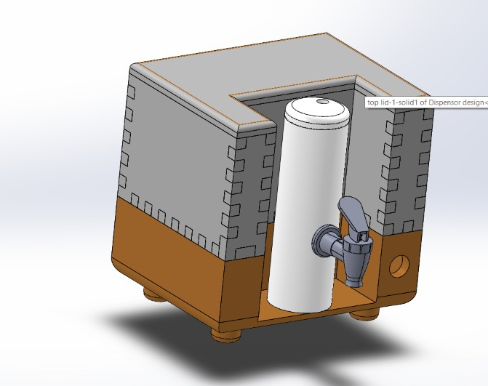
Hot Water Dispenser
Group 10

Slide 2
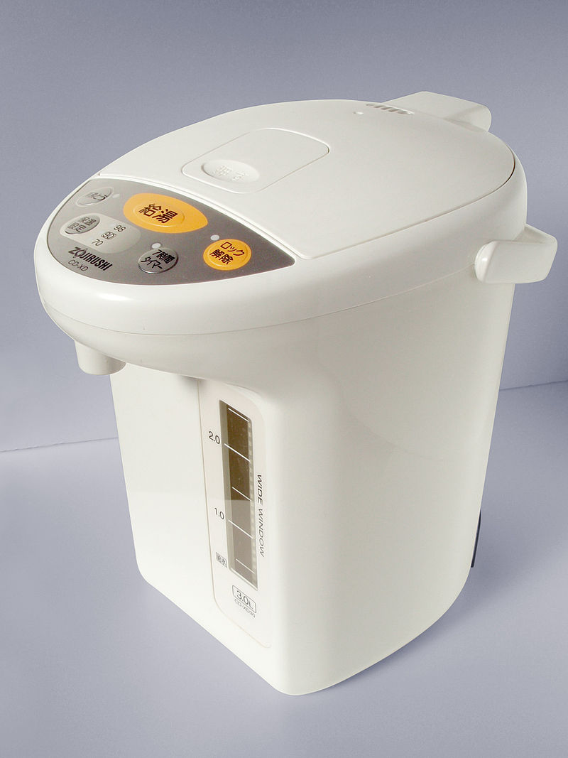
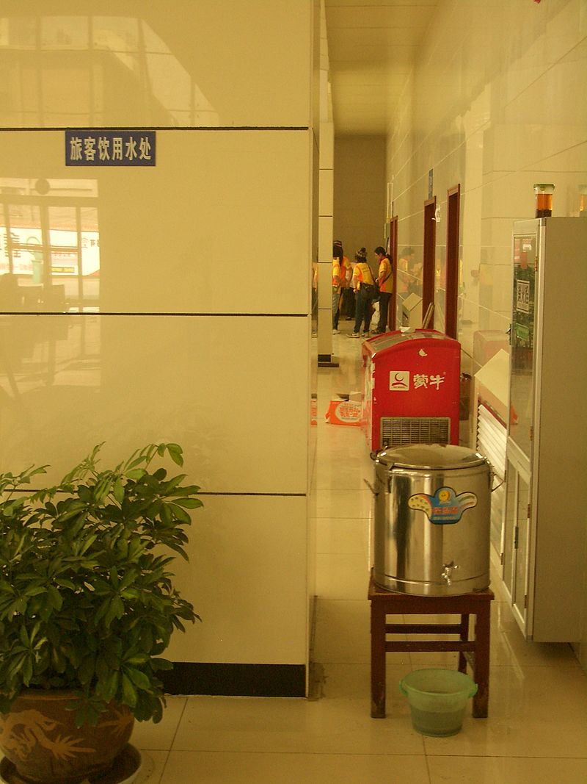
Introduction
There are various types of hot water dispensers.
A combination of boil-in-demand and water tank dispenser methods.

Slide 3
Overview
Temperature Controlling nob
Differentiator
PID Regulator
Voltage Control PWM Signal
Feedback
Coil
AC/DC Isolation
Temperature Display

Slide 4
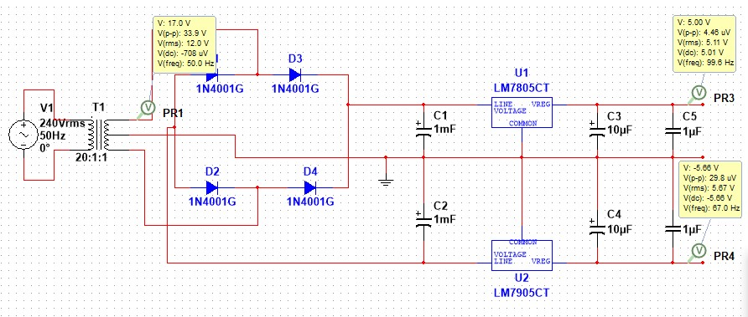
Dual power supply circuit

Slide 5
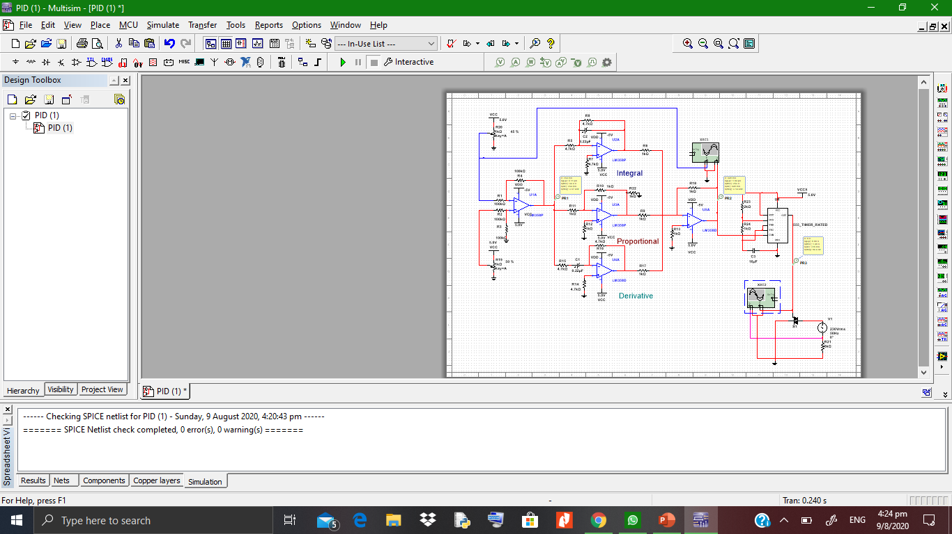
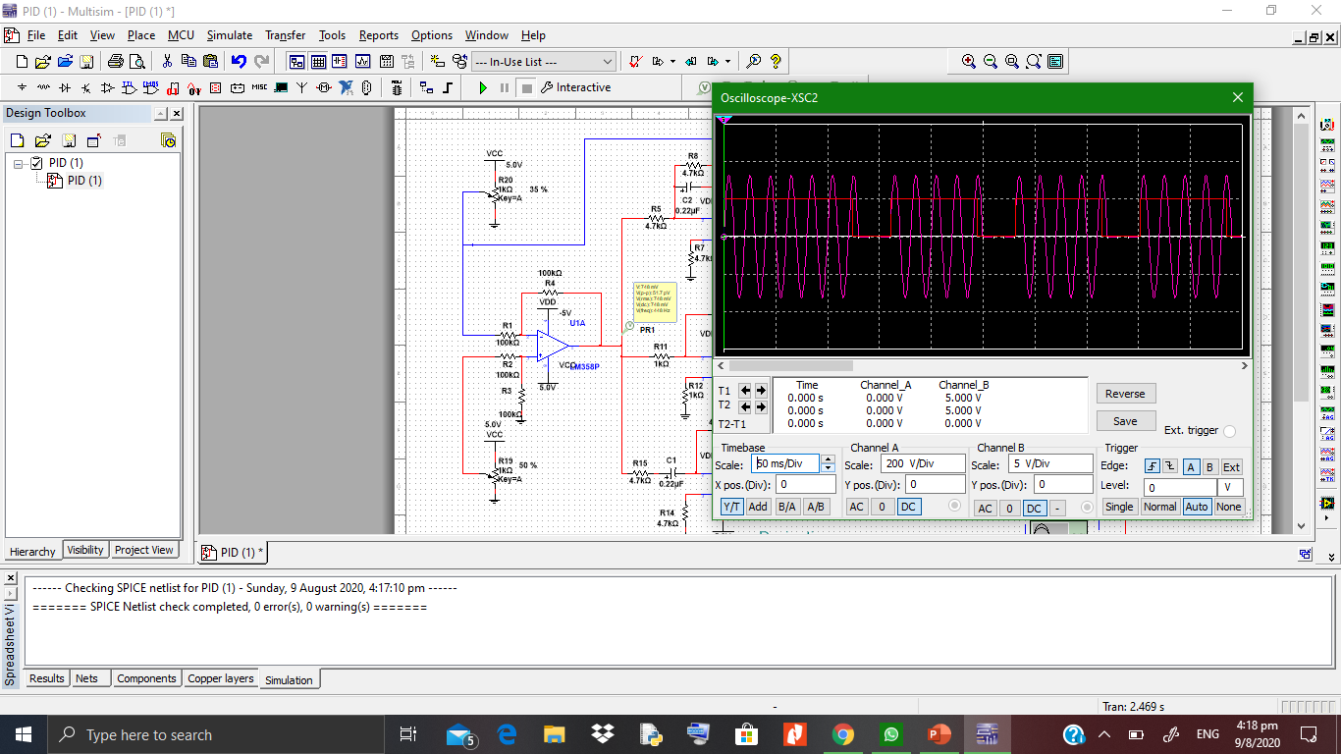
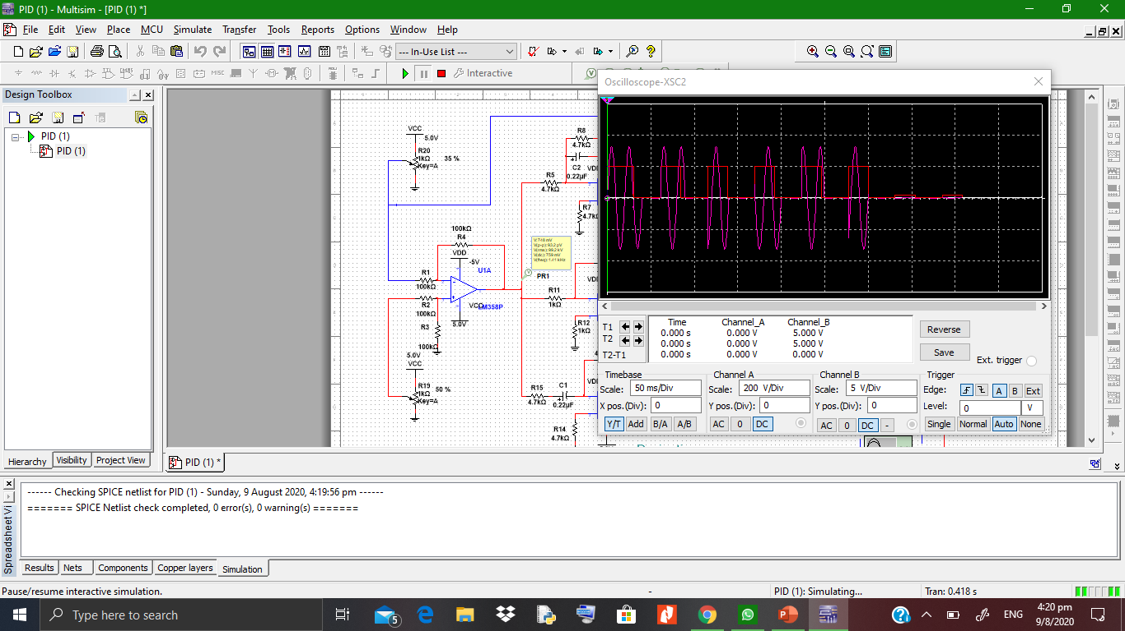
Control Circuit Simulations
Water Temperature more lesser than set point.
When it closes to set point.

Slide 6
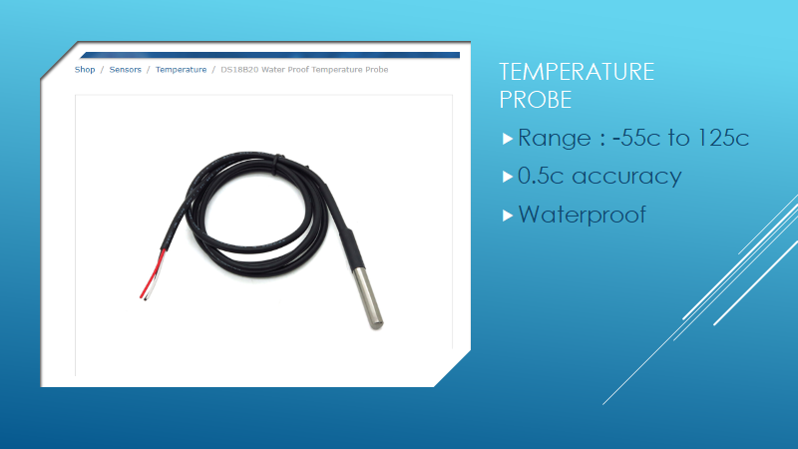

Slide 7
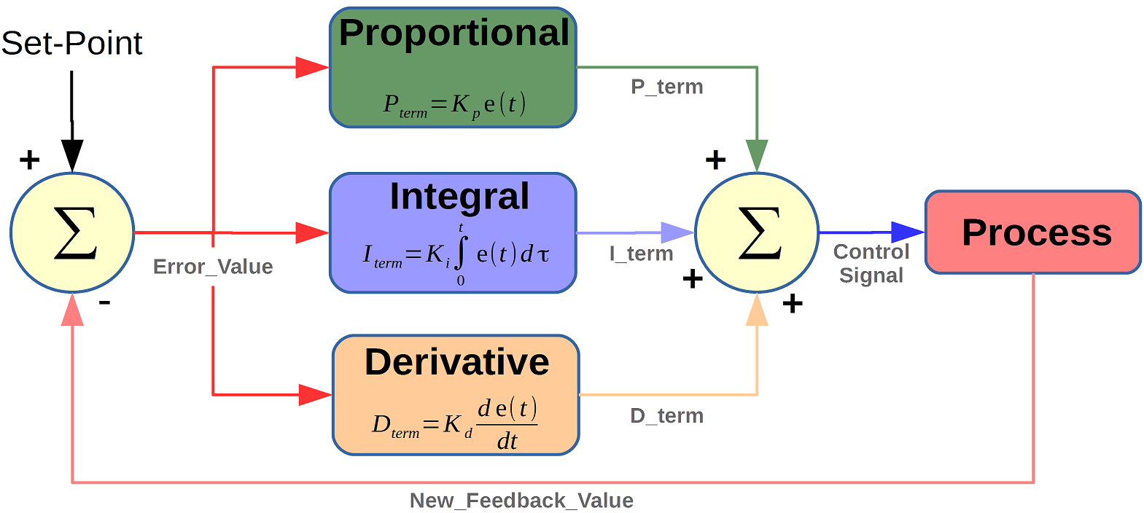
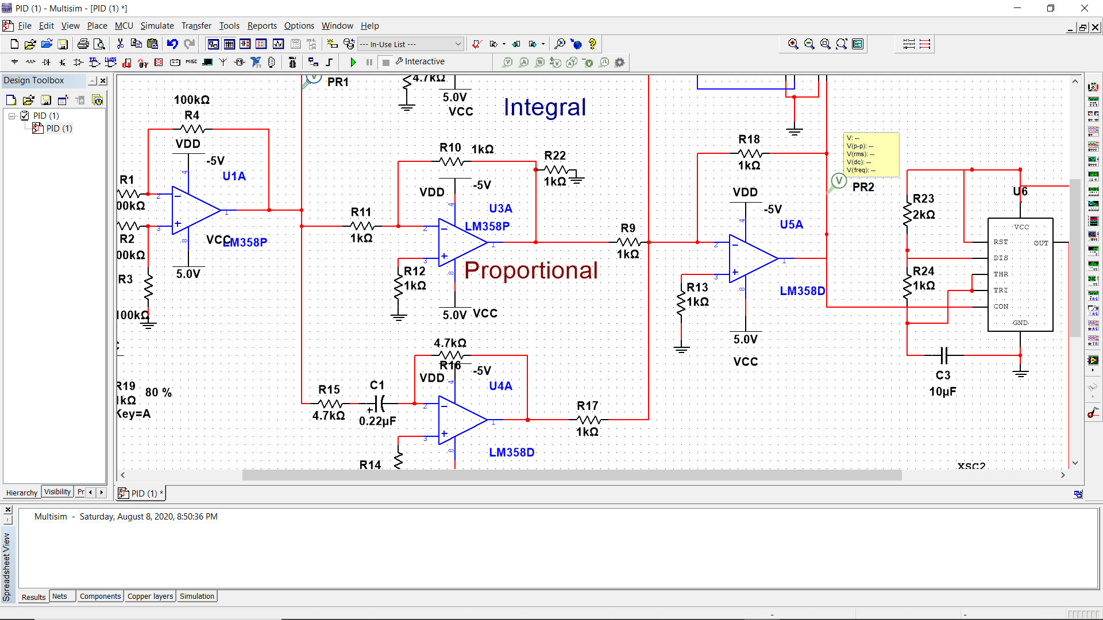
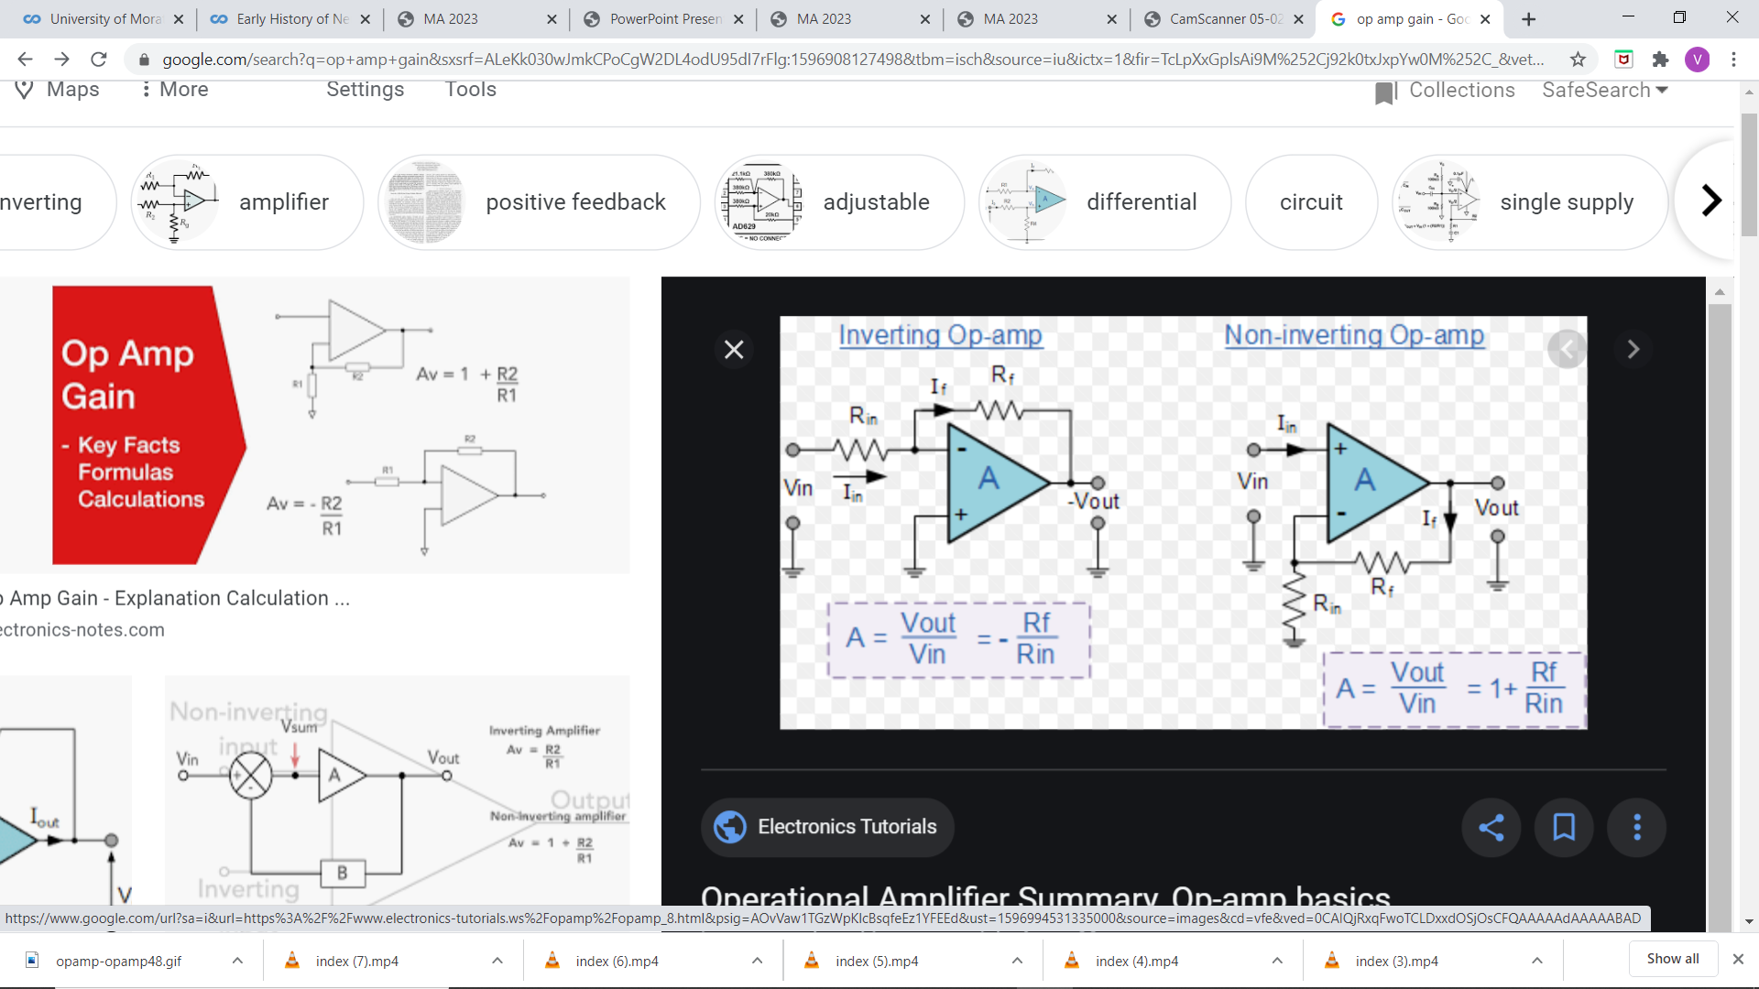
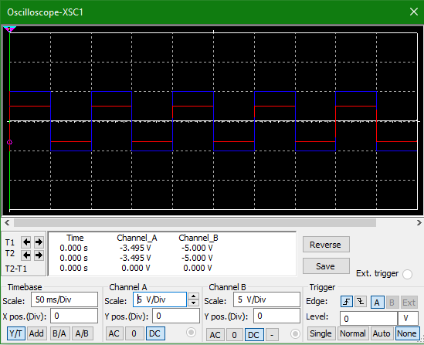
PID Constant calculation
Kp calculation
Kp= -1

Slide 8
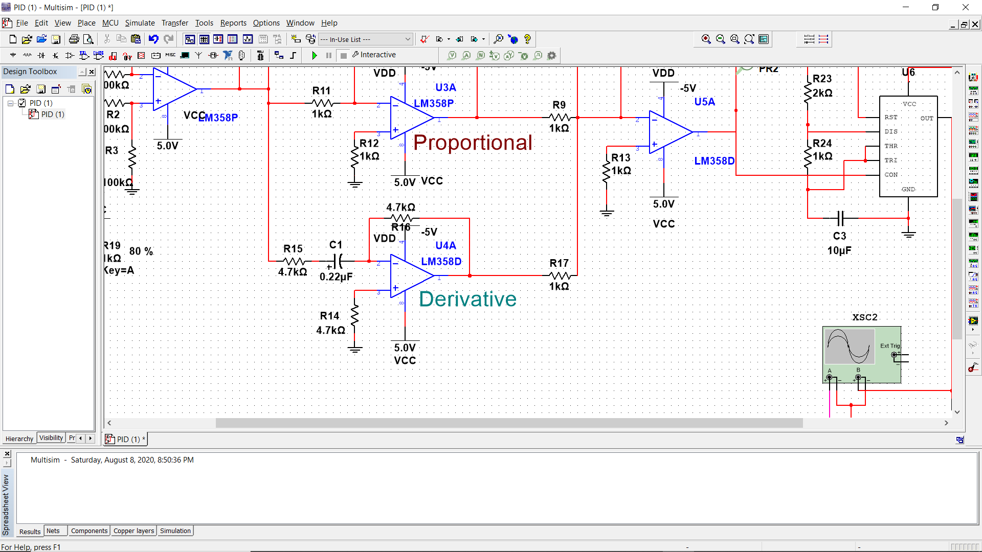
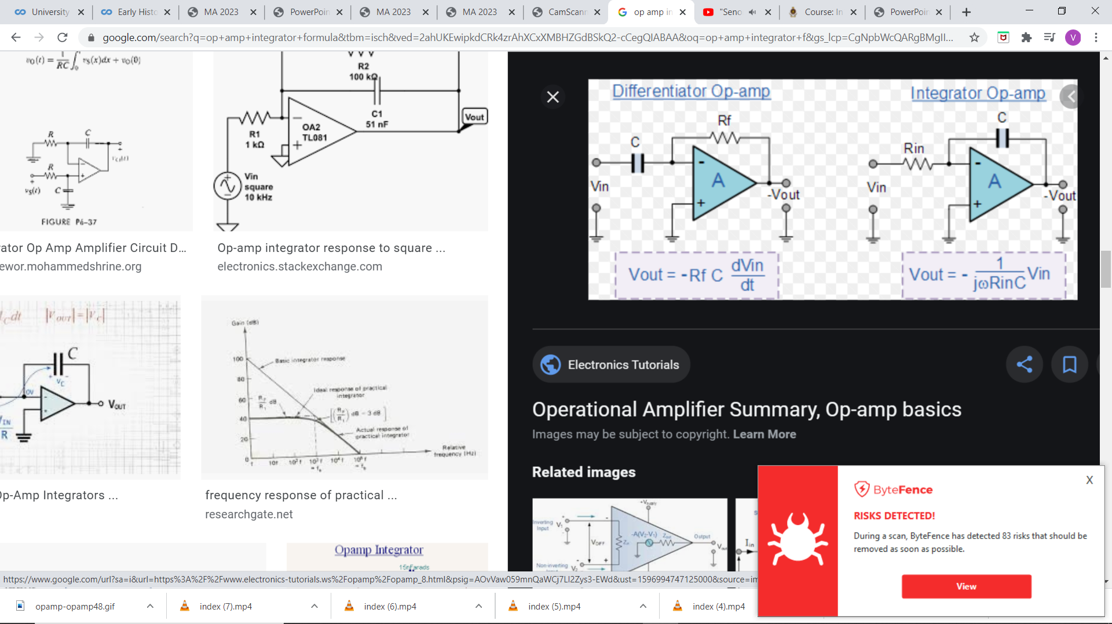
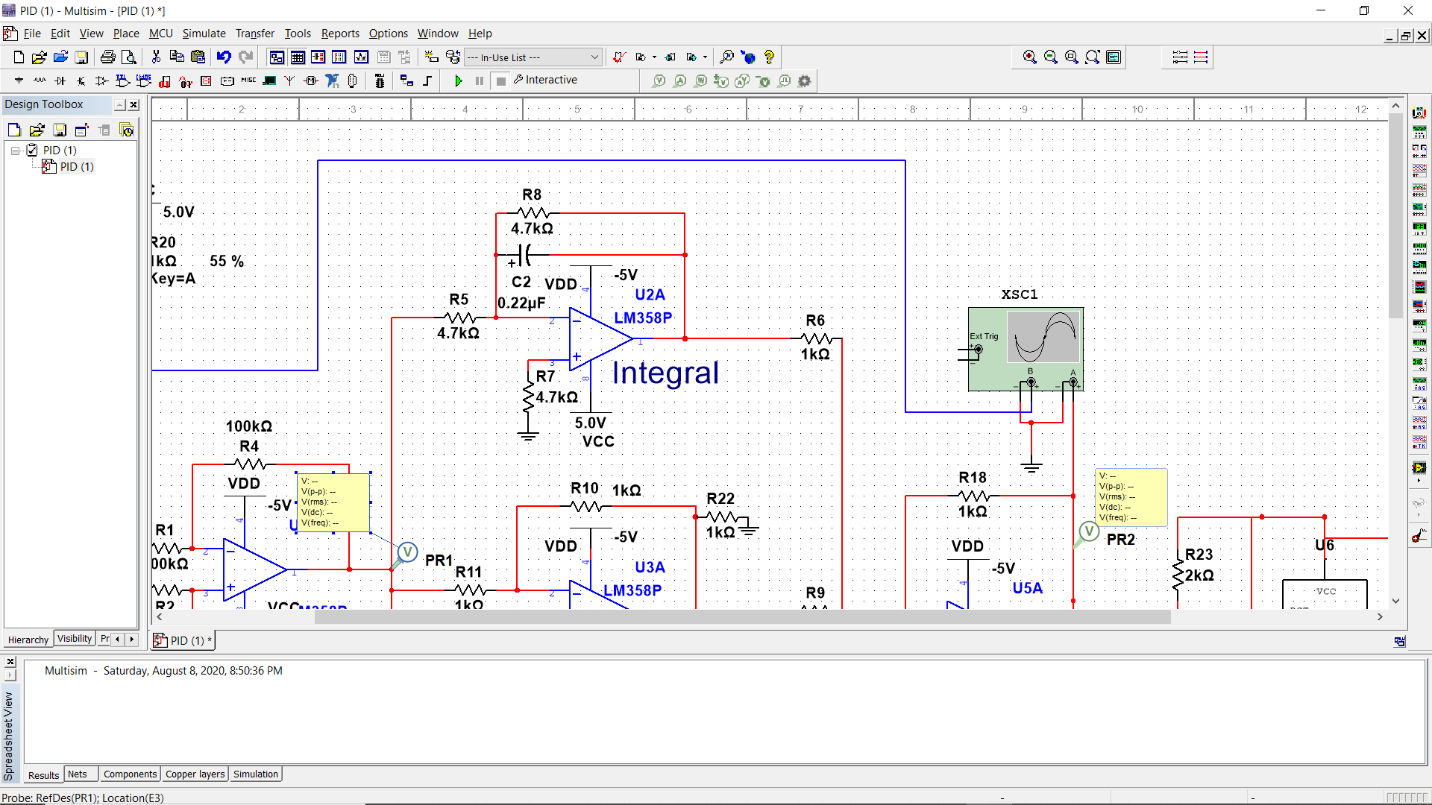
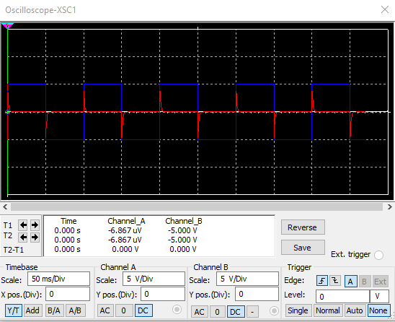
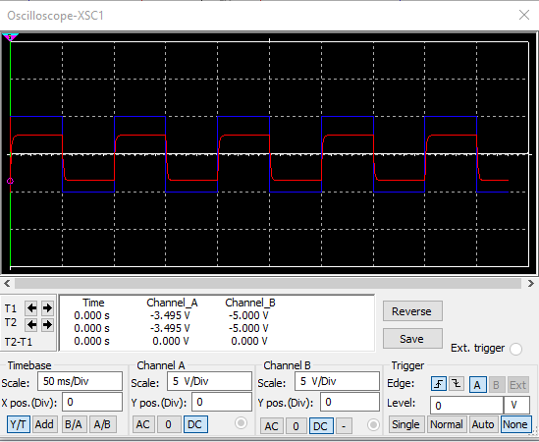
Kd Calculation
Ki Calculation
Kd= -1.034*10^-3
Ki= -967.118

Slide 9
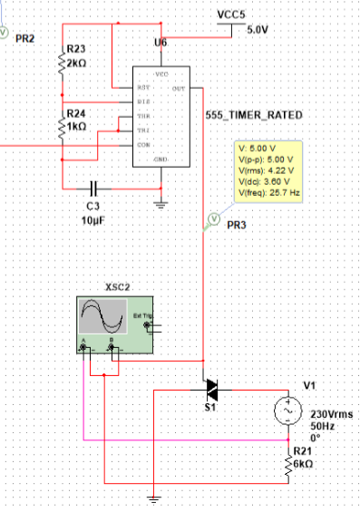
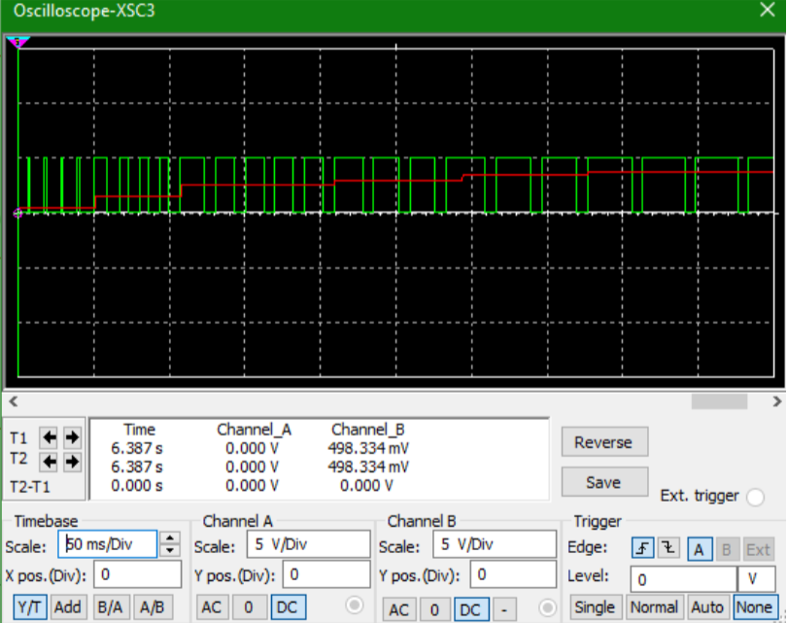
PWM Signal circuit

Slide 10
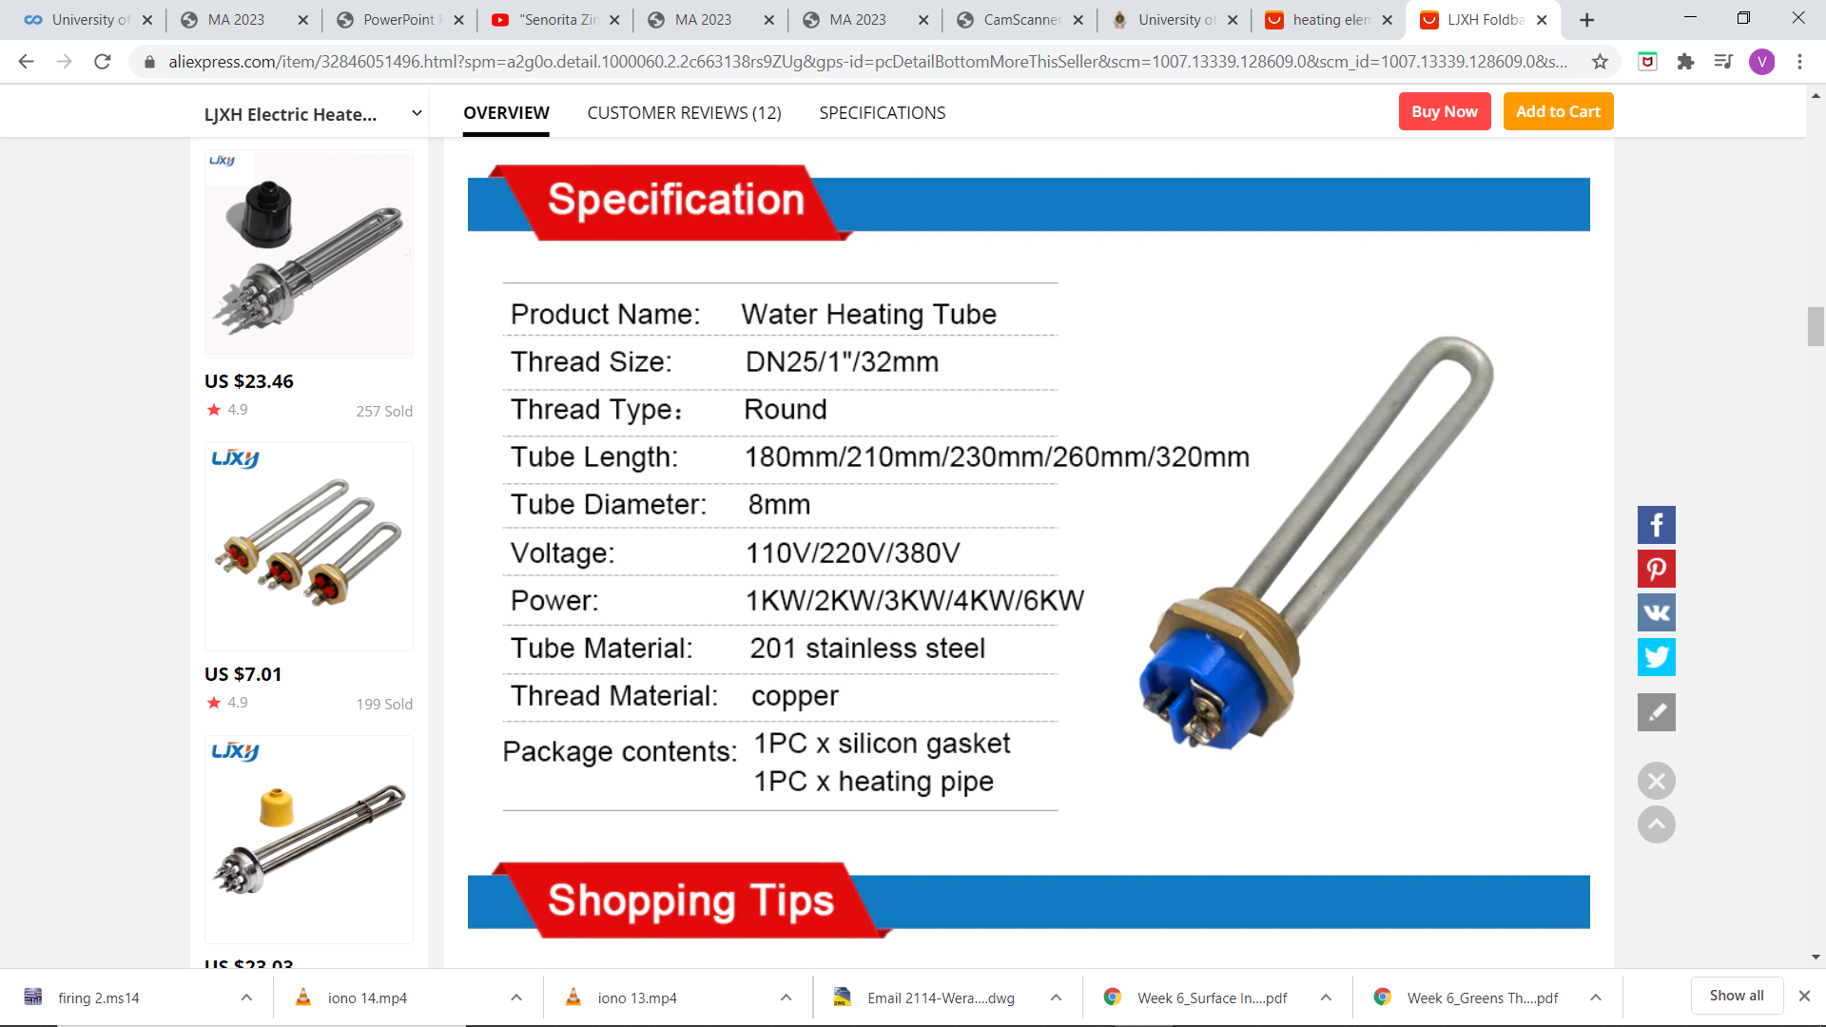
Power consumption
Maximum flow rate=1.8ml/s
Heating temperature range= 40°C-60°C
Room temperature= 25°C
Maximum power needed to heat water Pmax,
Pmax= maximum mass flow rate* thermal capacity*maximum temperature difference
= 265W

Slide 11
Boltzman constant=5.67*(10^-8)m^2kg/s^2K
Thermal conductivity of stainless steal= 16.3 W/mK
Emissivity of stainless steal= 0.85
Approximate area of the heater= π*(4^2)*(180*2)mm^2
Emitted thermal power when heating to 60°C Pemitted
Pemitted = Boltzman constant*(Thermal conductivity)^4*Emissivity*Area of the heater*((Tend)^4-(Tstart)^4)
= 5.67*(10^-8)*(16.3^4)*0.85*((333.15)^4-(298.15)^4)*(1.81*10^-5)
= 272W

Slide 12
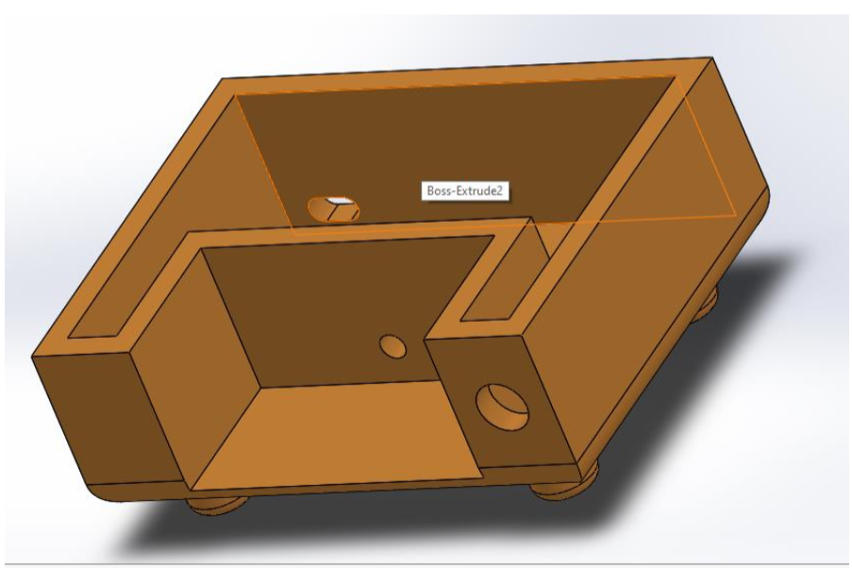
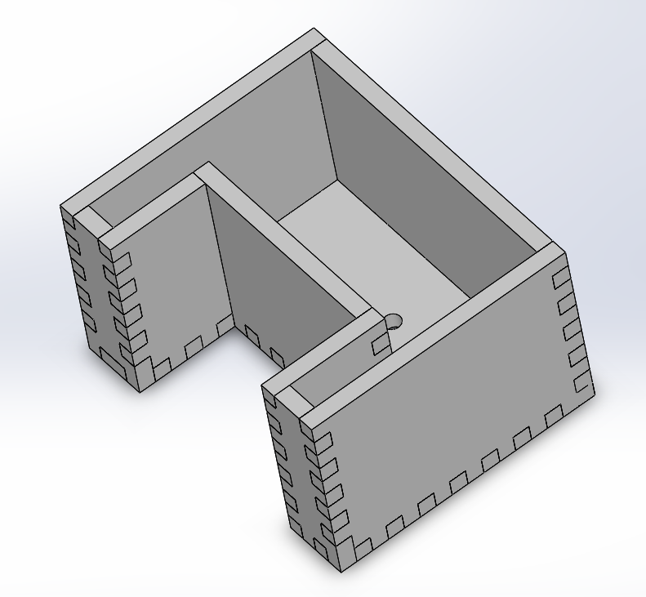
Solid works design
Base
Water Container

Slide 13
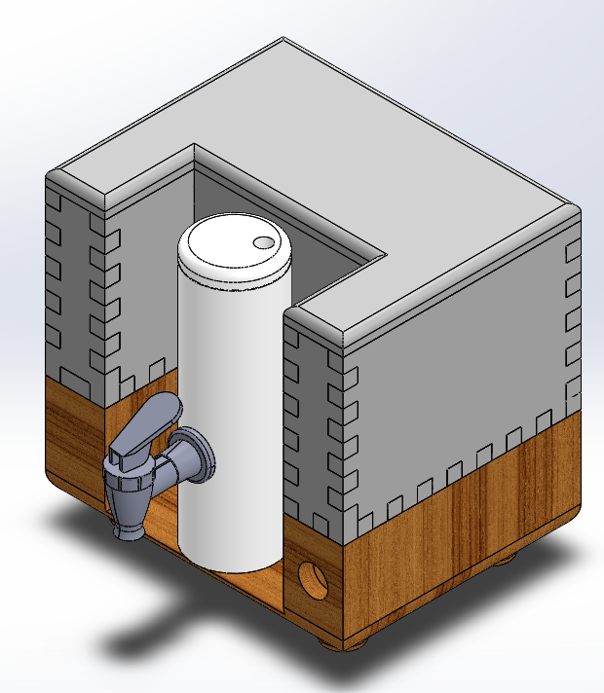
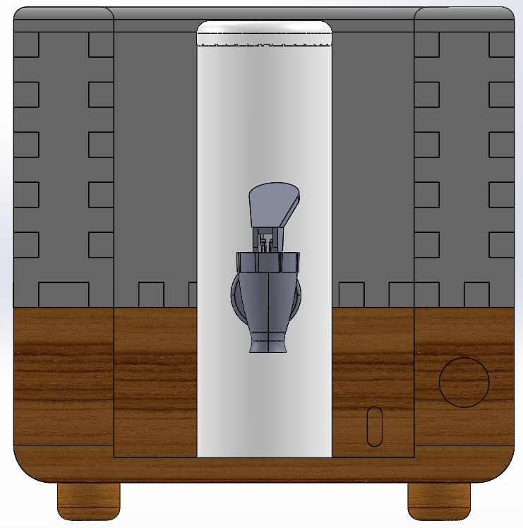
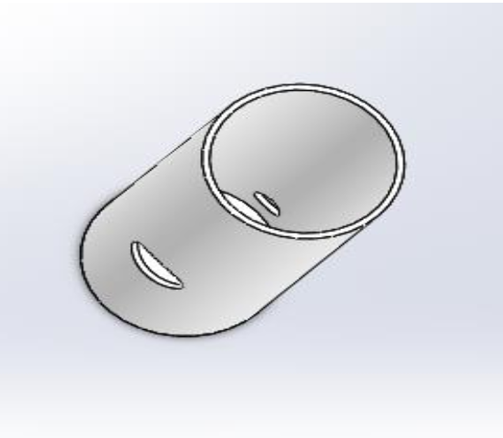
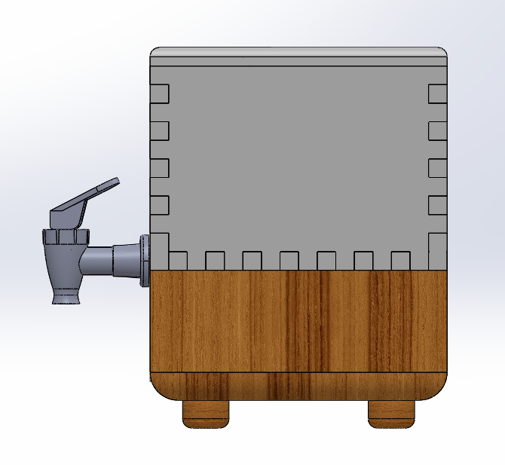
Heating Chamber
Overall Design

Slide 14
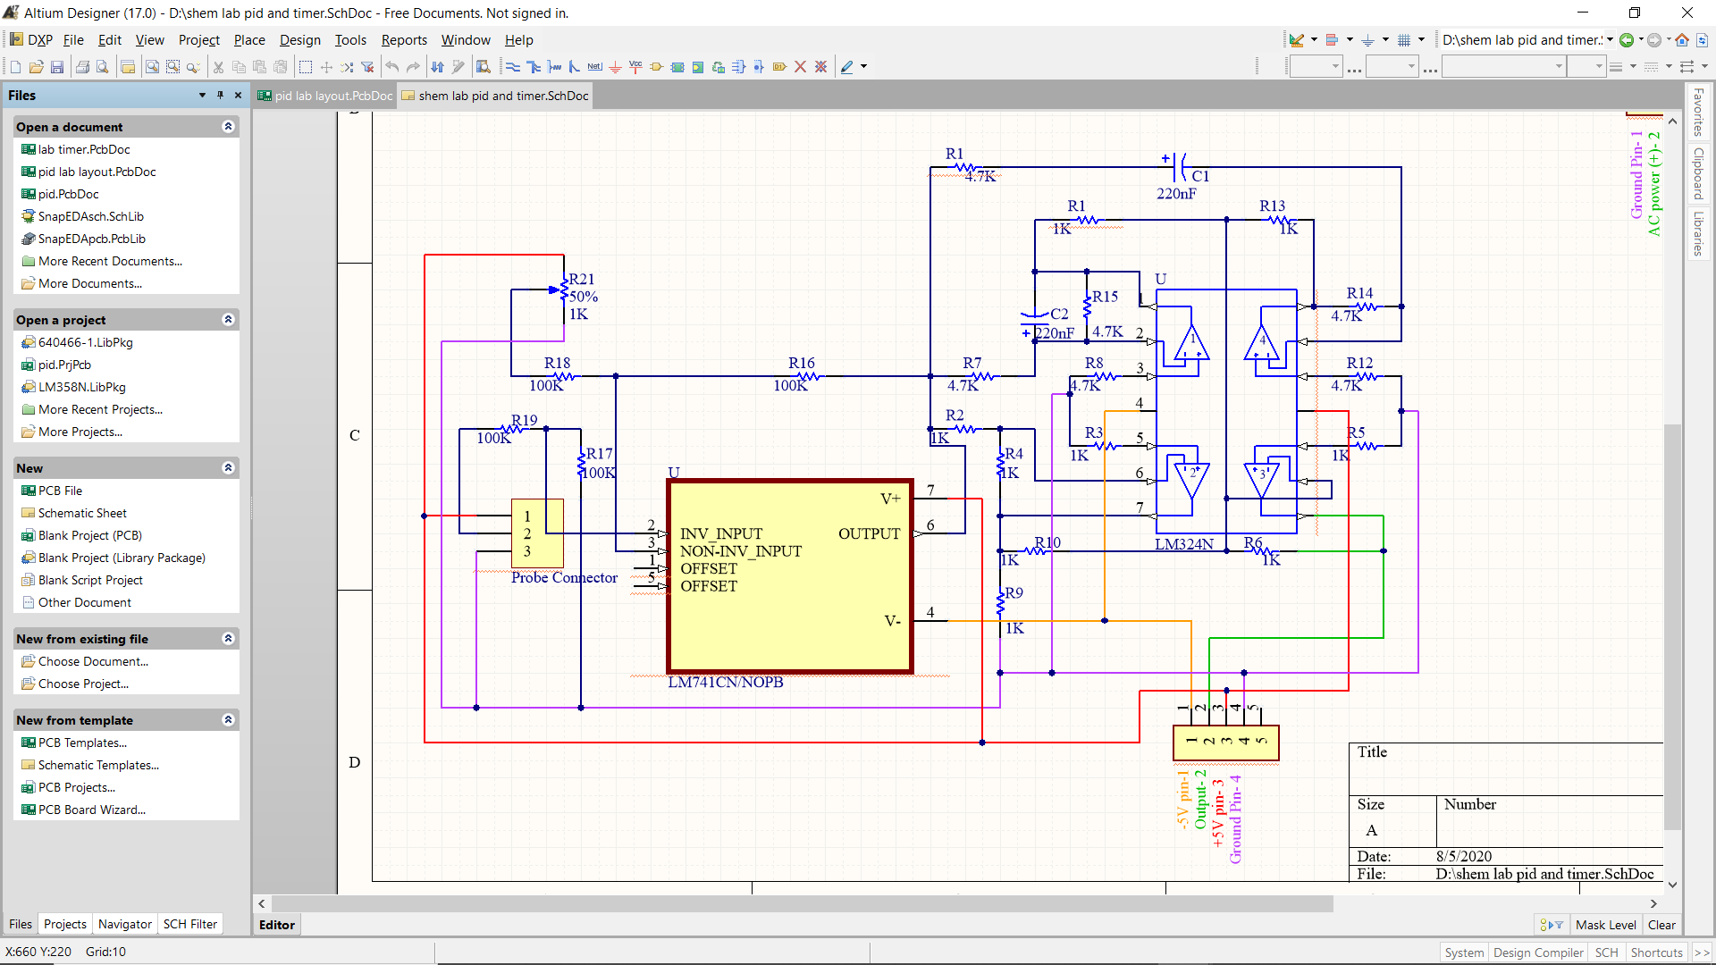
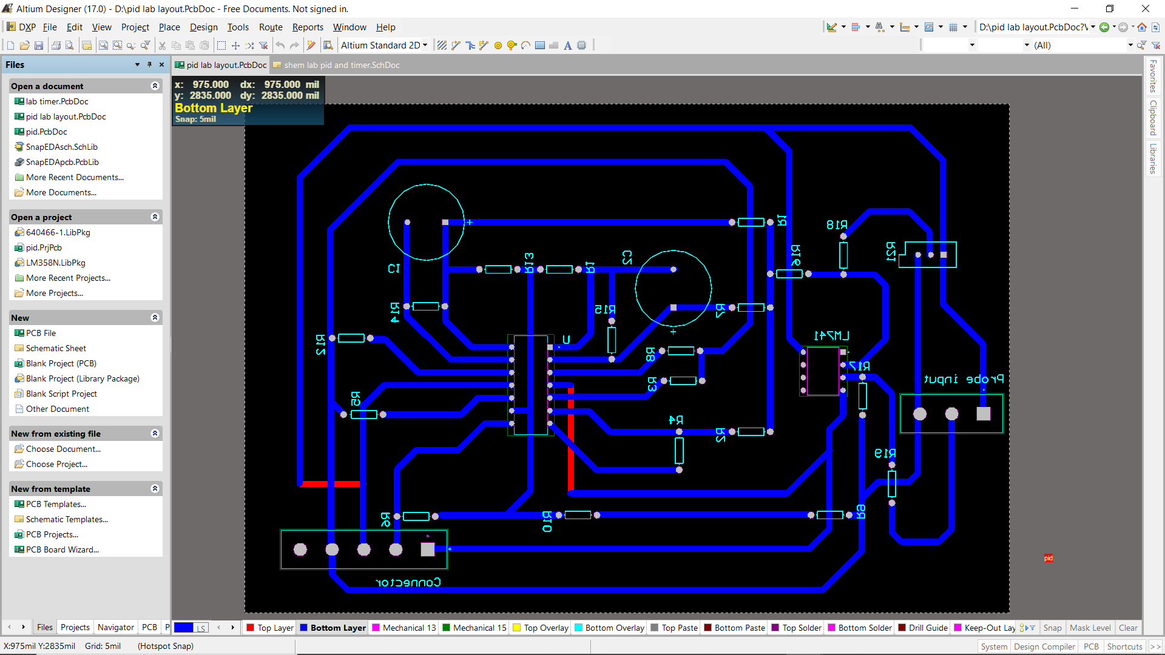
Altium Designs
PID Controlling Circuit
Schematic Design PCB Layout

Slide 15
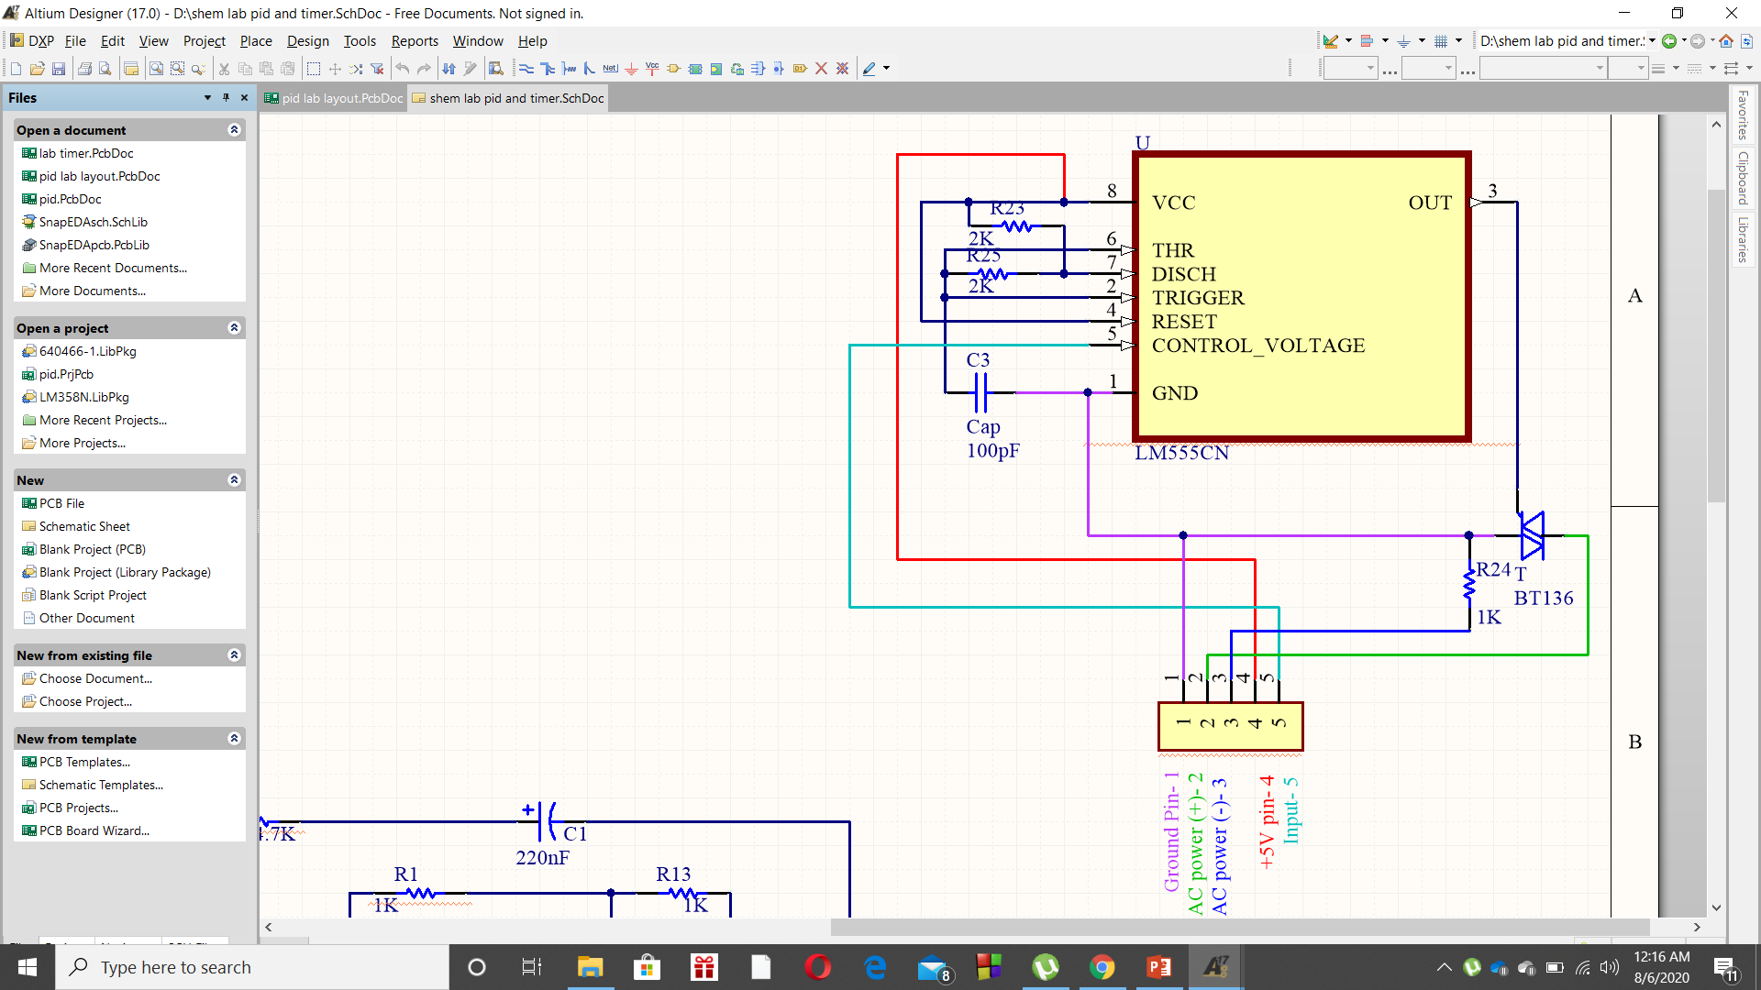
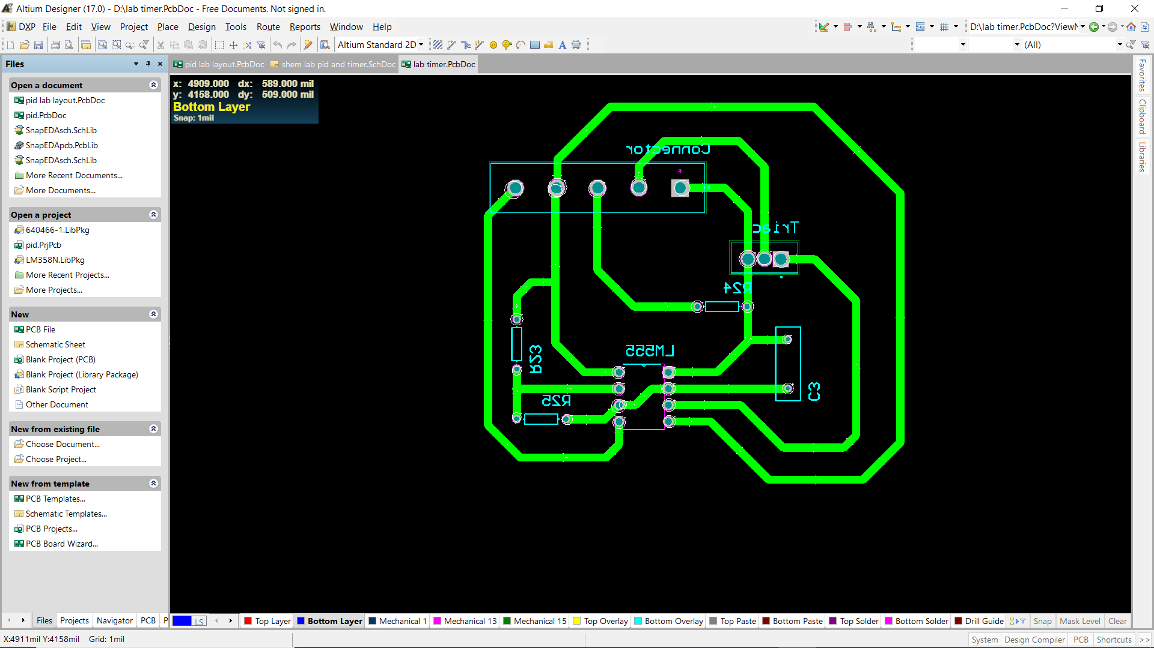
PWM Signal Generating Circuit
Schematic Design PCB Layout

Slide 16
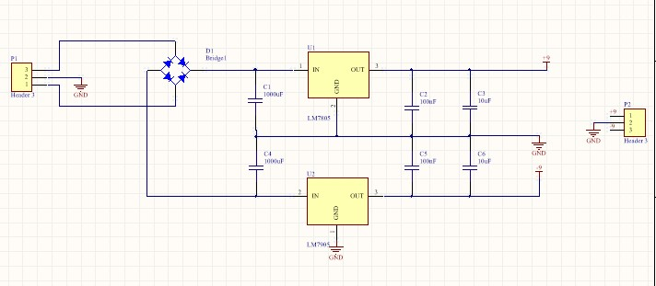
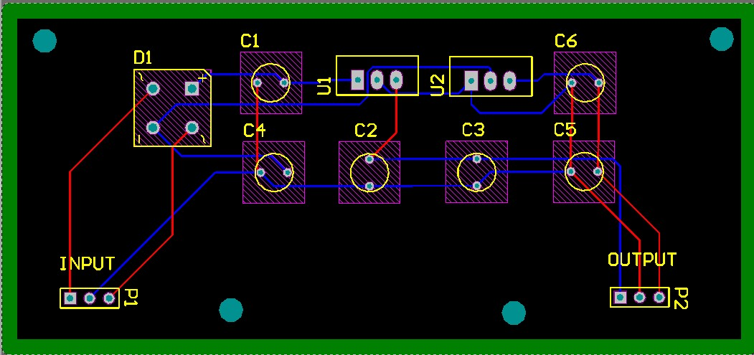
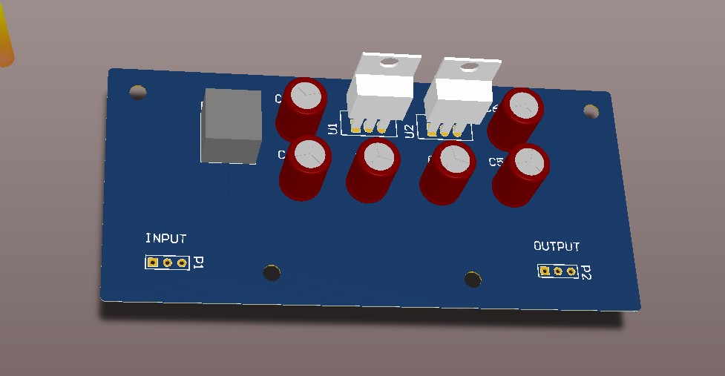
Schematic Design
PCB Layout
3D Design

